Slide 1
Test plan discussion
Air Cooler
--LDX

Slide 2
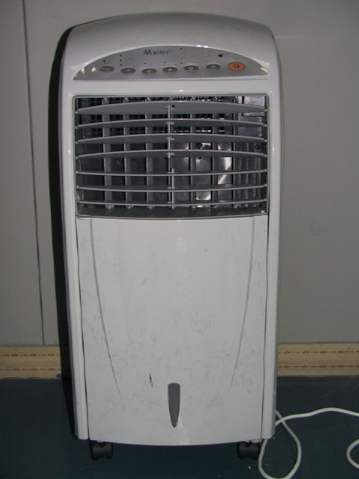
enclosure

Slide 3
Additional information- program chart
Operation mode:
Fan: High, mid, low
Swing
Timer
Generating Negative Ions
Operation mode:
Normal, Natural, Sleep
Cool & add wet

Slide 4
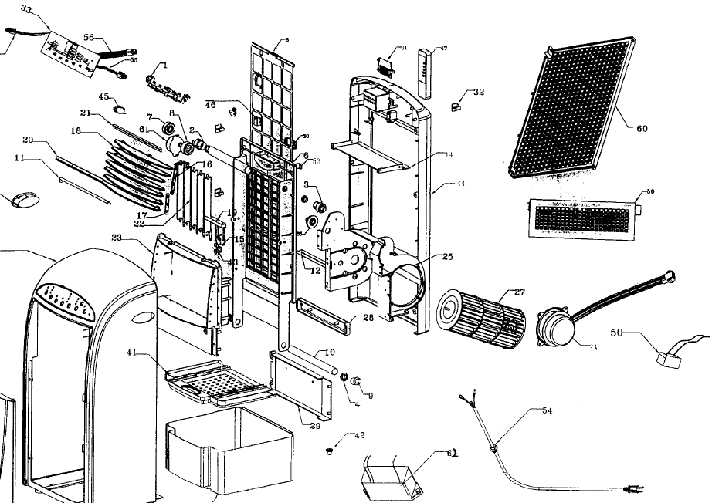
Circuit Diagram

Slide 5
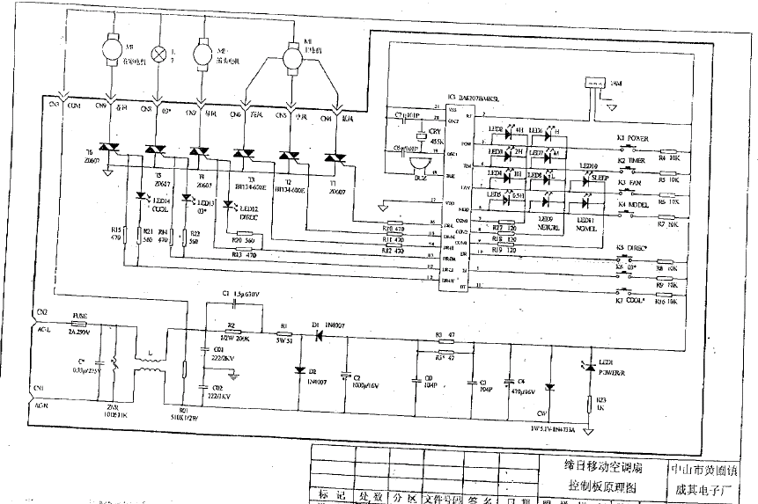
Circuit Diagram

Slide 6
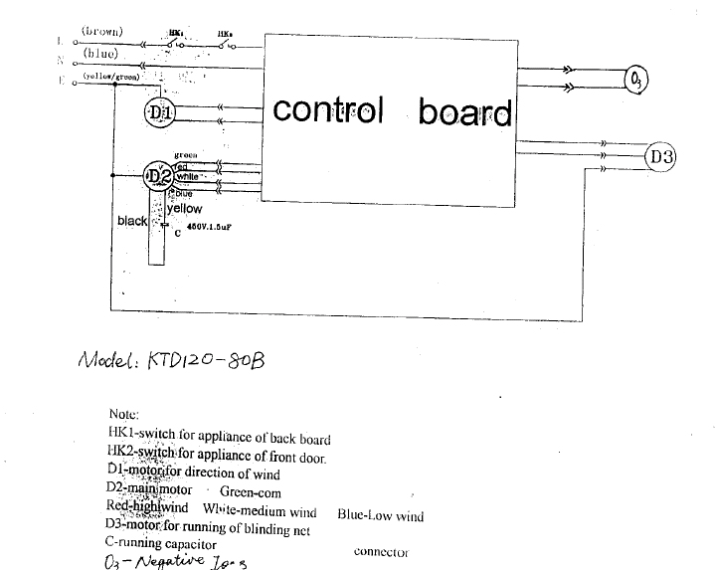
Circuit Diagram

Slide 7
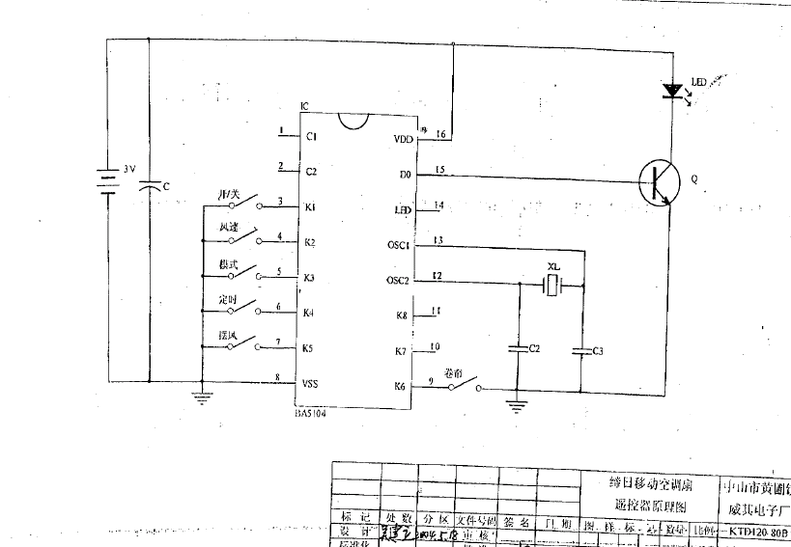
Circuit Diagram-remote controller

Slide 8
Disturbance Source
Ions generator
IC
Motor
Crystal osillator
TRIAC

Slide 9
Sensitive components for immunity test
IC
TRIAC

Slide 10
Applicable standards
EN 55014-1
EN 55014-2
EN 61000-3-2
EN 61000-3-3

Slide 11
Test items/operation modes
Harmonic and Flicker:
  On + Swing+ Normal + cool & wet +Ionizer+ High wind+Timer
DV and DP:
  On + Swing+ Normal + cool & wet +Ionizer+ high wind+Timer
  On + Swing+ Normal + cool & wet +Ionizer+ low wind+Timer

Slide 12
Test items/operation modes
Click:
on + sleep mode + ionizer on + swing + air cool + timer on
Immunity tests
  Standby (CS, EFT, ESD)
  sleep mode + air cool + timer on + ionizer on

